Slide 1

Topic 2 : Mechanics
Can you put the syllabus and definition sheet in your folders for our new topic
Notes:
At the start of each topic I always give out a copy of the syllabus for the topic and the definitions that need to be learnt.

Slide 2

Topic 1 TEST
Friday 26th September
Use the syllabus and learn the definitions
Past paper questions on Moodle (Paper 1 and 2)

Slide 3
This lesson
Sketching and interpreting motion graphs
Distance and displacement
Speed and velocity
Acceleration

Slide 4
Distance against time graphs
distance
time
Notes:
Students line up in the corridor every metre or 2 metres. I walk past them at a slow constant speed, fast constant speed, and accelerating. They stop watch after I go past (having all started as I start to move). We then go back in class and plot the distance/time graphs for each motion.

Slide 5
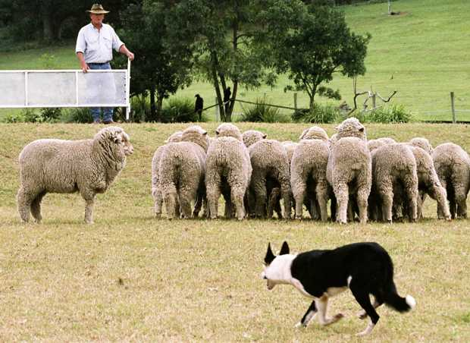
Can you quietly and sensibly follow Mr Porter?!
You’ll need a pencil and your books

Slide 6
Distance/time graph
Distance /m | 0 | 1 | 2 | 3 | 4 | 5 | 6 | 7 | 8 | 9 | 10 | 11 | 12
Time 1/s ± 0.1 s | 0 | 1.2 | 2.2 | 3.7 | 4.1 | 5.0 | 5.9 | 6.9 | 7.9 | 8.4 | 9.7 | 10.4 | 11.7
Time 2/s ± 0.1 s | 0 | 0.7 | 1.3 | 1.9 | 2.0 | 2.6 | 2.9 | 3.4 | 3.8 | 4.1 | 4.7 | 5.3 | 5.9
Time 3/s ± 0.1 s | 0 | 2.2 | 4.0 | 5.3 | 6.0 | 6.5 | 7.5 | 8.1 | 9.0 | 9.3 | 9.8 | 10.2 | 10.6
Distance /m | 13 | 14 | 15 | 16 | 17 | 18 | 19 | 20 | 21 | 22 | 23
Time 1/s ± 0.1 s | 12.3 | 13.1 | 14.0 | 15.0 | 15.9 | 16.4 | 17.6 | 18.5 | 19.3 | 20.1 | 21.0
Time 2/s ± 0.1 s | 6.2 | 6.6 | 7.1 | 7.6 | 8.3 | 8.5 | 9.0 | 9.7 | 10.1 | 10.3 | 11.0
Time 3/s ± 0.1 s | 11.0 | 11.3 | 11.2 | 11.9 | 12.2 | 12.2 | 12.3 | 12.8 | 13.0 | 13.1 | 13.2

Slide 7
Constant speed?
distance
time
Notes:
Get students to come up and sketch the graph

Slide 8
Constant speed
distance
time

Slide 9
Constant speed
distance
The gradient of this graph gives the speed
time

Slide 10

Constant speed
How would the graph look different for a faster constant speed?
distance
time
Notes:
Again, ask someone to come up and sketch the graph.

Slide 11
Constant speed
fast
distance
time

Slide 12
Constant speed
fast
How would the graph look different for a slower constant speed?
distance
time
Notes:
Again, ask someone to come up and sketch the graph.

Slide 13
Constant speed
fast
distance
slow
time

Slide 14
Getting faster? (accelerating)
distance
time
Notes:
Again, ask someone to come up and sketch the graph.

Slide 15
Getting faster (accelerating)
distance
time

Slide 16
Examples
distance
time

Slide 17
A car accelerating from rest and then hitting a wall
distance
time

Slide 18
A car accelerating from stop and then hitting a wall
distance
time

Slide 19
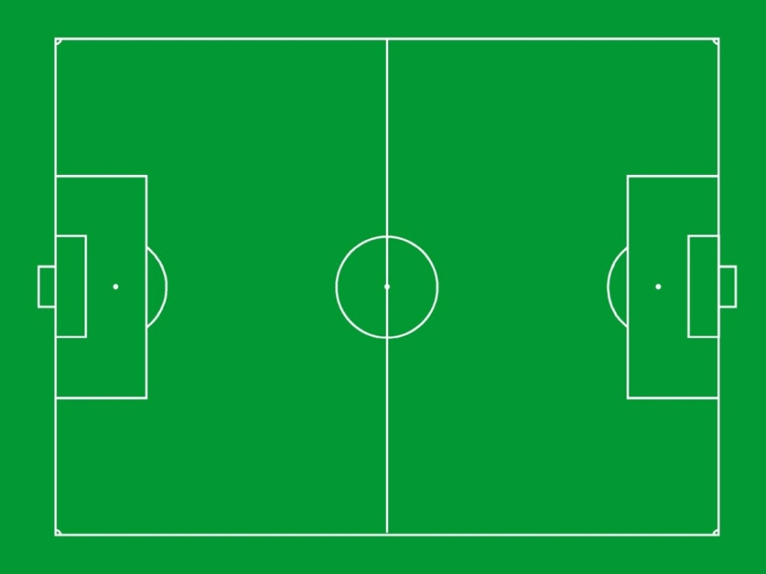
Displacement
Displacement the distance moved in a stated direction (the distance and direction from the starting point). A VECTOR

Slide 20
Displacement/time graphs
Usually in 1 dimension (+ = forward and - = backwards)
Faster constant speed backwards
Displacement/m
Time/s
Constant speed forwards

Slide 21
Displacement/time graphs
Gradient gives the VELOCITY
Negative
Displacement/m
Time/s
Positive

Slide 22
Speed against time graphs
speed
time

Slide 23
No movement?
speed
time
Notes:
Again, get a student to sketch it.

Slide 24
No movement
speed
time

Slide 25
Constant speed?
speed
time
Notes:
Again, get a student to sketch it.

Slide 26
Constant speed
speed
time

Slide 27
Constant speed
How would the graph look different for a faster constant speed?
speed
time
Notes:
Again, get a student to sketch it.

Slide 28
Constant speed
speed
fast
time

Slide 29
Constant speed
How would the graph look different for a slower constant speed?
speed
fast
time
Notes:
Again, get a student to sketch it.

Slide 30
Constant speed
speed
fast
slow
time

Slide 31
Getting faster? (accelerating)
speed
time
Notes:
Again, get a student to sketch it.

Slide 32
Getting faster? (accelerating)
speed
Constant acceleration
time

Slide 33
Getting faster? (accelerating)
speed
The gradient of this graph gives the acceleration
time

Slide 34
Getting faster? (accelerating)
v
The gradient of this graph gives the acceleration
speed
a = v – u
t
(v= final speed, u = initial speed)
u
time

Slide 35
Getting faster? (accelerating)
speed
The area under the graph gives the distance travelled
time

Slide 36
Example:
speed
time

Slide 37
A dog falling from a tall building (no air resistance)
speed
time

Slide 38
A dog falling from a tall building (no air resistance)
speed
time

Slide 39
A dog falling from a tall building (no air resistance)
speed
Area = height of building
time

Slide 40
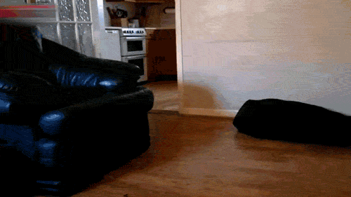
Velocity?

Slide 41
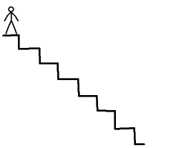
Velocity?
Velocity is the rate of change of displacement. Also a VECTOR

Slide 42
Velocity/time graphs
Usually in 1 dimension (+ = forward and - = backwards)
Ball being thrown into the air, gradient = constant = -9.81 m.s⁻²
velocity/m.s⁻¹
Time/s

Slide 43
Velocity/time graphs
Area = displacement
velocity/m.s⁻¹
Time/s

Slide 44
Velocity/time graphs
Gradient = acceleration
If falling, magnitude of gradient = 9.8 m.s⁻²
velocity/m.s⁻¹
Time/s

Slide 45
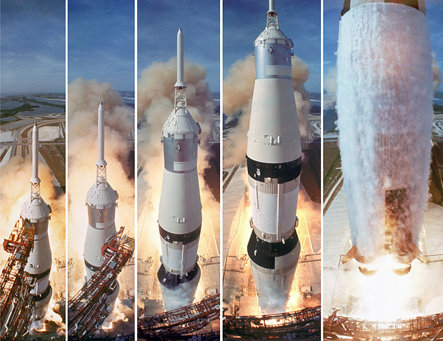
Acceleration?

Slide 46
Acceleration?
Acceleration is the rate of change of velocity. Also a VECTOR

Slide 47


An interesting example
Think of a dog (dead) orbiting the earth with constant speed (in a circle).
Notes:
47

Slide 48
An interesting example
At this point, what is its velocity?
velocity?
Notes:
48

Slide 49
An interesting example
velocity
Notes:
49

Slide 50
An interesting example
What is its velocity here?
velocity?
Notes:
50

Slide 51
An interesting example
As you can see the velocity has changed as it is now going in another direction.
velocity
Notes:
51

Slide 52
An interesting example
We have constant speed but changing velocity.
velocity
Notes:
52

Slide 53
An interesting example
We have constant speed but changing velocity.
Of course a changing velocity means it must be accelerating!
velocity
Notes:
53

Slide 54
Acceleration/time graphs
Usually in 1 dimension (+ = up and - = down)
accel/m.s⁻²
Time/s

Slide 55
Projectiles
Usually in 1 dimension (+ = up and - = down)
Acceleration = constant = -9.81 m.s⁻²
accel/m.s⁻²
Time/s

Slide 56
Note!
The area under an acceleration/time graph gives the change in velocity
acceleration
time

Slide 57
Be careful! Constant speed
speed
distance
time
Gradient = speed
Area = distance travelled
time

Slide 58
Be careful! Constant acceleration
speed
Gradient = acceleration
a = (v-u)/t
distance
time
Area = distance travelled
time

Slide 59
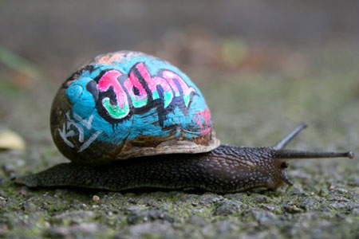
Average speed/velocity?
Average speed/velocity is change in distance/displacement divided by time taken over a period of time.

Slide 60
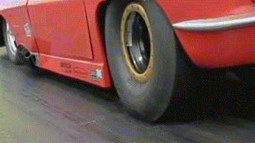
Instantaneous speed/velocity?
Instantaneous speed/velocity is the change in distance/displacement divided by time at one particular time.

Slide 61
This lesson
Equations of motion for uniform acceleration

Slide 62

“Definitions” TEST
You will be having a test of the topic 2 definitions on Monday 29th September

Slide 63
The equations of motion
The equations of motion can be used when an object has constant acceleration.
There are four equations relating five quantities
u initial velocity, v final velocity,
s displacement, a acceleration, t time
SUVAT equations

Slide 64
The four equations
1 |  | This is a re-arrangement of
2 |  | This says displacement = average velocity x time
3 |  | With zero acceleration, this becomes displacement = velocity x time
4 |  | Useful when you don’t know the time

Slide 65
Beware!
All quantities are vectors (except time!). These equations are normally done in one dimension, so a negative result means displacement/velocity/acceleration in the opposite direction.

Slide 66
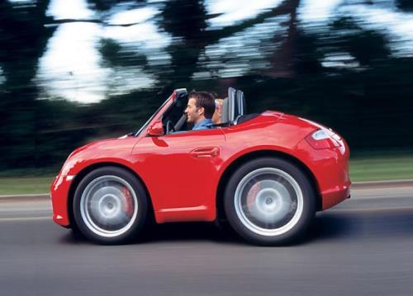
Example 1
Mr Blanchard is driving his car, when suddenly the engine stops working! If he is travelling at 10 m.s⁻¹ and his decceleration is 2 m.s⁻² how long will it take for the car to come to rest?

Slide 67
Example 1
Mr Blanchard is driving his car, when suddenly the engine stops working! If he is travelling at 10 m.s⁻¹ and his decceleration is 2 m.s⁻² how long will it take for the car to come to rest?
What does the question tell us. Write it out.

Slide 68
Example 1
Mr Blanchard is driving his car, when suddenly the engine stops working! If he is travelling at 10 m.s⁻¹ and his decceleration is 2 m.s⁻² how long will it take for the car to come to rest?
u = 10 m.s⁻¹
v = 0 m.s⁻¹
a = -2 m.s⁻²
t = ? s

Slide 69
Example 1
Mr Blanchard is driving his car, when suddenly the engine stops working! If he is travelling at 10 m.s⁻¹ and his decceleration is 2 m.s⁻² how long will it take for the car to come to rest?
u = 10 m.s⁻¹
v = 0 m.s⁻¹
a = -2 m.s⁻²
t = ? s
Choose the equation that has these quantities in
v = u + at

Slide 70
Example 1
Mr Blanchard is driving his car, when suddenly the engine stops working! If he is travelling at 10 m.s⁻¹ and his decceleration is 2 m.s⁻² how long will it take for the car to come to rest?
u = 10 m.s⁻¹ v = 0 m.s⁻¹ a = -2 m.s⁻² t = ? s
v = u + at
0 = 10 + -2t
2t = 10
t = 5 seconds

Slide 71
Example 2
Sara steps into the road, 30 metres from where Mr Blanchard’s engine stops working. Mr Blanchard does not see Sara. Will the car stop in time to miss hitting Sara?

Slide 72
Example 2
Sara steps into the road, 30 metres from where Mr Blanchard’s engine stops working. Mr Blanchard does not see Sara. Will the car stop in time to miss hitting Sara?
What does the question tell us. Write it out.

Slide 73
Example 2
Sara steps into the road, 30 metres from where Mr Blanchard’s engine stops working. Mr Blanchard does not see Sara. Will the car stop in time to miss hitting Sara?
u = 10 m.s⁻¹
v = 0 m.s⁻¹
a = -2 m.s⁻²
t = 5 s
s = ? m

Slide 74
Example 2
Sara steps into the road, 30 metres from where Mr Blanchard’s engine stops working. Mr Blanchard does not see Sara. Will the car stop in time to miss hitting Sara?
u = 10 m.s⁻¹ v = 0 m.s⁻¹ a = -2 m.s⁻² t = 5 s s = ? m
Choose the equation that has these quantities in
v² = u² + 2as

Slide 75
Example 2
Sara steps into the road, 30 metres from where Mr Blanchard’s engine stops working. Mr Blanchard does not see Sara. Will the car stop in time to miss hitting Sara?
u = 10 m.s⁻¹ v = 0 m.s⁻¹ a = -2 m.s⁻² t = 5 s s = ? m
v² = u² + 2as
0² = 10² + 2x-2s
0 = 100 -4s
4s = 100
s = 25m, the car does not hit Jan. ☹

Slide 76
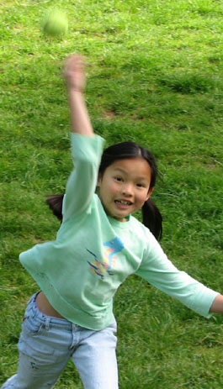
Example 3
A ball is thrown upwards with a velocity of 24 m.s⁻¹.

Slide 77

Example 3
A ball is thrown upwards with a velocity of 24 m.s⁻¹.
When is the velocity of the ball 12 m.s⁻¹?

Slide 78
Example 3
A ball is thrown upwards with a velocity of 24 m.s⁻¹.
When is the velocity of the ball 12 m.s⁻¹?
u = 24 m.s⁻¹ a = -9.8 m.s⁻² v = 12 m.s⁻¹
t = ?

Slide 79
Example 3
A ball is thrown upwards with a velocity of 24 m.s⁻¹.
When is the velocity of the ball 12 m.s⁻¹?
u = 24 m.s⁻¹ a = -9.8 m.s⁻² v = 12 m.s⁻¹
t = ?
v = u + at

Slide 80
Example 3
A ball is thrown upwards with a velocity of 24 m.s⁻¹.
When is the velocity of the ball 12 m.s⁻¹?
u = 24 m.s⁻¹ a = -9.8 m.s⁻² v = 12 m.s⁻¹
v = u + at
12 = 24 + -9.8t
-12 = -9.8t
t = 12/9.8 = 1.2 seconds

Slide 81
Example 3
A ball is thrown upwards with a velocity of 24 m.s⁻¹.
When is the velocity of the ball -12 m.s⁻¹?

Slide 82
Example 3
A ball is thrown upwards with a velocity of 24 m.s⁻¹.
When is the velocity of the ball -12 m.s⁻¹?
u = 24 m.s⁻¹ a = -9.8 m.s⁻² v = -12 m.s⁻¹
t = ?

Slide 83
Example 3
A ball is thrown upwards with a velocity of 24 m.s⁻¹.
When is the velocity of the ball -12 m.s⁻¹?
u = 24 m.s⁻¹ a = -9.8 m.s⁻² v = -12 m.s⁻¹
v = u + at

Slide 84
Example 3
A ball is thrown upwards with a velocity of 24 m.s⁻¹.
When is the velocity of the ball -12 m.s⁻¹?
u = 24 m.s⁻¹ a = -9.8 m.s⁻² v = -12 m.s⁻¹
v = u + at
-12 = 24 + -9.8t
-36 = -9.8t
t = 36/9.8 = 3.7 seconds

Slide 85
Example 3
A ball is thrown upwards with a velocity of 24 m.s⁻¹.
What is the displacement of the ball at those times? (t = 1.2, 3.7)

Slide 86
Example 3
A ball is thrown upwards with a velocity of 24 m.s⁻¹.
What is the displacement of the ball at those times? (t = 1.2, 3.7)
t = 1.2, v = 12, a = -9.8, u = 24 s = ?

Slide 87
Example 3
A ball is thrown upwards with a velocity of 24 m.s⁻¹.
What is the displacement of the ball at those times? (t = 1.2, 3.7)
t = 1.2, v = 12, a = -9.8, u = 24 s = ?
s = ut + ½at² = 24x1.2 + ½x-9.8x1.2²
s = 28.8 – 7.056 = 21.7 m

Slide 88
Example 3
A ball is thrown upwards with a velocity of 24 m.s⁻¹.
What is the displacement of the ball at those times? (t = 1.2, 3.7)
t = 3.7, v = 12, a = -9.8, u = 24 s = ?
s = ut + ½at² = 24x3.7 + ½x-9.8x3.7²
s = 88.8 – 67.081 = 21.7 m (the same?!)

Slide 89
Example 3
A ball is thrown upwards with a velocity of 24 m.s⁻¹.
What is the velocity of the ball 1.50 s after launch?

Slide 90
Example 3
A ball is thrown upwards with a velocity of 24 m.s⁻¹.
What is the velocity of the ball 1.50 s after launch?
u = 24, t = 1.50, a = -9.8, v = ?

Slide 91
Example 3
A ball is thrown upwards with a velocity of 24 m.s⁻¹.
What is the velocity of the ball 1.50 s after launch?
u = 24, t = 1.50, a = -9.8, v = ?
v = u + at

Slide 92
Example 3
A ball is thrown upwards with a velocity of 24 m.s⁻¹.
What is the velocity of the ball 1.50 s after launch?
u = 24, t = 1.50, a = -9.8, v = ?
v = u + at
v = 24 + -9.8x1.50 = 9.3 m.s⁻¹

Slide 93
Example 3
A ball is thrown upwards with a velocity of 24 m.s⁻¹.
What is the maximum height reached by the ball?

Slide 94
Example 3
A ball is thrown upwards with a velocity of 24 m.s⁻¹.
What is the maximum height reached by the ball?
u = 24, a = -9.8, v = 0, s = ?

Slide 95
Example 3
A ball is thrown upwards with a velocity of 24 m.s⁻¹.
What is the maximum height reached by the ball?
u = 24, a = -9.8, v = 0, s = ?
v² = u² + 2as
0 = 576 + 2x-9.8xs
0 = 576 -19.6s

Slide 96
Example 3
A ball is thrown upwards with a velocity of 24 m.s⁻¹.
What is the maximum height reached by the ball?
u = 24, a = -9.8, v = 0, s = ?
0 = 576 -19.6s
19.6s = 576
s = 576/19.6 = 29.4 m

Slide 97

9/11

Slide 98
9/11
Height = 417 m
a = 9.8 m.s⁻²
u = 0 m.s⁻¹
v = ?
t = ?

Slide 99
9/11
s = ut + ½at²
417 = 0xt + ½x9.8t²
417 = 4.9t²
t² = 85.1
t = 9.2 s

Slide 100
9/11
v = u + at
v = 0 + 9.8 x 9.2
v = 90.2 m.s⁻¹ (325 km.h⁻¹)
(Assuming no air resistance)

Slide 101

Let’s do some questions
2.1 Basic suvat questions worksheet

Slide 102

HOMEWORK
Finish the SUVAT questions for next lesson (Thursday)

Slide 103
Make your own questions!
Using the Guinness Book of records (or similar)

Slide 104
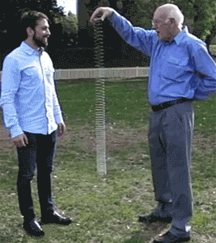
2.1 Measuring “g” investigation

Slide 105
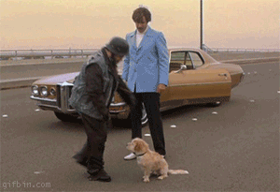
This lesson
Projectile motion

Slide 106
Amazing facts!
If a gun is fired horizontally, and at the same time a bullet is dropped from the same height, which bullet hits the ground first?
Notes:
You can demonstrate this with monkey-hunter apparatus or a ruler and two coins.

Slide 107
Amazing facts!

Slide 108
Amazing facts!

Slide 109
Amazing facts!
They both hit the ground at the same time!

Slide 110
Amazing facts!
Mr Porter can demonstrate this for you.

Slide 111
Amazing facts!
Why?

Slide 112
Vertical and horizontal
Their vertical motion can be considered separate from their horizontal motion.
Explanation of projectile motion

Slide 113
Vertical and horizontal
Vertically, they both have zero initial velocity and accelerate downwards at 9.8 m.s⁻². The time to fall the same vertical distance is therefore the same. We assume constant horizontal speed

Slide 114
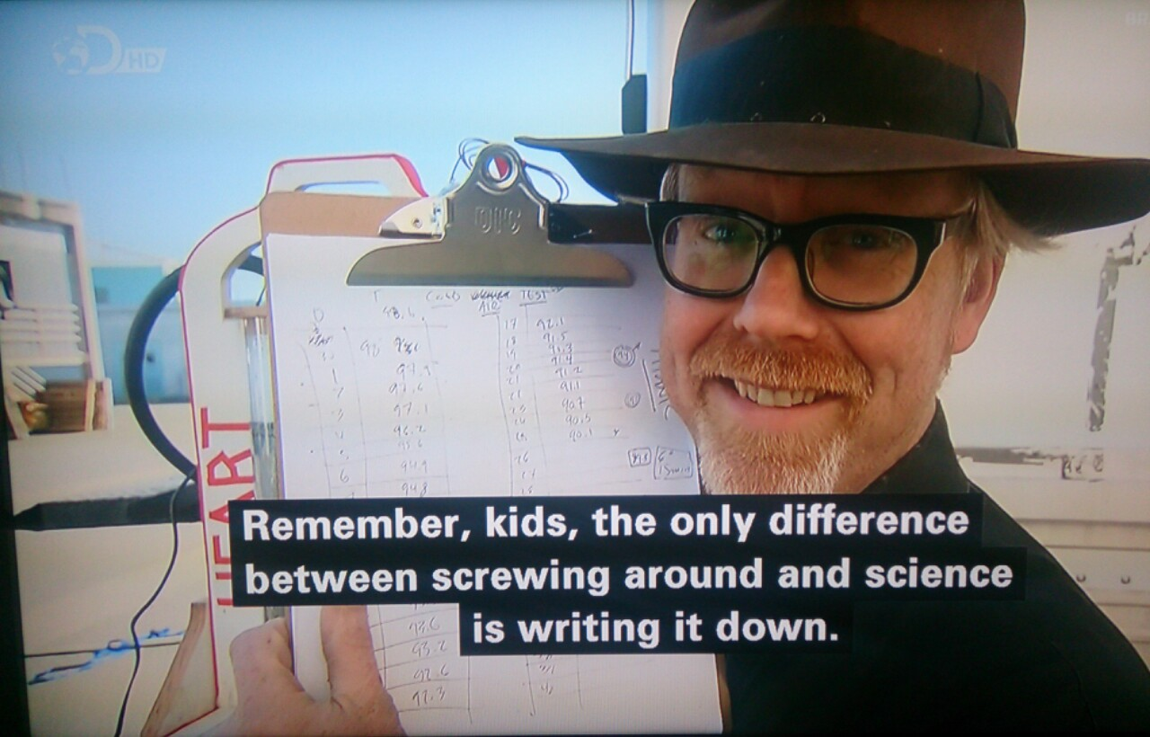
Mythbusters tried this!
Dropped bullet versus fired bullet

Slide 115
Example
A dog is kicked off the top of a cliff with an initial horizontal velocity of 5 m.s⁻¹. If the cliff is 30 m high, how far from the cliff bottom will the dog hit the ground?
5 m.s⁻¹
30 m

Slide 116
Vertical motion
Assuming no air resistance, there is constant force downwards (=mg).
This means vertically the
dog moves with constant
acceleration g = 9.8 m.s⁻²

Slide 117
Horizontal motion
Assuming no air resistance, there are no horizontal forces.
This means horizontally
the dog moves with
constant speed

Slide 118
Example
Looking at vertical motion first:
u = 0, a = 9.8 m.s⁻², s = 30 m, t = ?
s = ut + ½at²
30 = ½ x 9.8 x t²
t² = 6.1
t = 2.47 s
The dog hits the ground after 2.47 seconds (yes!)
5 m.s⁻¹
30 m

Slide 119
Example
Now look at horizontal motion:
Constant speed (horizontally) = 5 m.s⁻¹
Time of fall = 2.47 seconds
Horizontal distance travelled = speed x time
Horizontal distance travelled = 5 x 2.47
= 12.4 m The dog hits the ground 12.4 metres from the base of the cliff
5 m.s⁻¹
30 m

Slide 120
Parabola
12.4 metres

Slide 121
What is the dog’s speed as he hits the ground?
To answer this it is easier to think in terms of the dog’s total energy (kinetic and potential)
5 m.s⁻¹
30 m

Slide 122
What is the dog’s speed as he hits the ground?
Total energy at top = ½mv² + mgh
Total energy = ½m(5)² + mx9.8x30
Total energy = 12.5m + 294m = 306.5m
5 m.s⁻¹
30 m

Slide 123
What is the dog’s speed as he hits the ground?
At the bottom, all the potential energy has been converted to kinetic energy. All the dog’s energy is now kinetic.
energy = ½mv²
V = ?

Slide 124
What is the dog’s speed as he hits the ground?
energy at top = energy at bottom
306.5m = ½mv²
306.5 = ½v²
613 = v²
V = 24.8 m.s⁻¹
(Note that this is the dog’s
speed as it hits the ground,
not its velocity.
v = 24.8 m.s⁻¹

Slide 125
What is the dog’s velocity as he hits the ground?
This can be found by vector addition of his final vertical and horizontal velocity as he hits the ground.
Looking at vertical motion first:
u = 0, a = 9.8 m.s⁻², s = 30 m, v = ?
v² = u² + 2as
v² = 0² + 2 x 9.8 x 30 = 588
v = 24.2 m.s⁻¹

Slide 126
What is the dog’s velocity as he hits the ground?
The horizontal velocity is constant (5 m.s⁻¹) so the final velocity overall is
(24.2² + 5²)^{½} = 24.7 m.s⁻¹
24.2 m.s⁻¹
5 m.s⁻¹

Slide 127
What is the dog’s velocity as he hits the ground?
The horizontal velocity is constant (5 m.s⁻¹) so the final velocity overall is
θ
tanθ = 5/24.2 = 0.207
θ = tan⁻¹0.207 = 11.7°
24.2 m.s⁻¹
5 m.s⁻¹

Slide 128

Let’s try some questions.
2.1 Projectile motion with initial horizontal motion problems

Slide 129
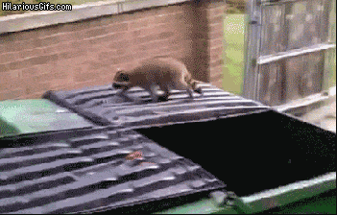
Can you find your projectile motion questions?

Slide 130

Starting with non-horizontal motion
Woof! (help)

Slide 131

Starting with non-horizontal motion
25 m.s⁻¹
30°

Slide 132
Starting with non-horizontal motion
Split the initial velocity into vertical and horizontal components
v_{h} = 25cos30°
v_{v} = 25sin30°
25 m.s⁻¹
30°

Slide 133
Starting with non-horizontal motion
2. Looking at the vertical motion, when the dog hits the floor, displacement = 0
Initial vertical velocity = v_{v} = 25sin30°
Acceleration = - 9.8 m.s⁻²
25 m.s⁻¹
30°

Slide 134
Starting with non-horizontal motion
3. Using s = ut + ½at²
0 = 25sin30°t + ½(-9.8)t²
0 = 12.5t - 4.75t²
0 = 12.5 – 4.75t
4.75t = 12.5
t = 12.5/4.75 = 2.63 s
25 m.s⁻¹
30°

Slide 135

Starting with non-horizontal motion
4. Looking at horizontal motion
Ball in flight for t = 2.63 s travelling with constant horizontal speed of
v_{h} = 25cos30° = 21.7 m.s⁻¹.
Distance travelled = v_{h}t = 21.7x2.63 = 57.1m
30°
57.1m

Slide 136
Starting with non-horizontal motion
5. Finding maximum height? Vertically;
v = 0, u = 25sin30°, t = 2.63/2
s = (u + v)t = 12.5x1.315 = 8.2m
2 2
30°

Slide 137
Starting with non-horizontal motion
6. Don’t forget some problems can also be answered using energy.
30°

Slide 138
Starting with non-horizontal motion
6. Don’t forget some problems can also be answered using energy.
As dog is fired total energy = ½m(25)²
25 m.s⁻¹
30°

Slide 139
Starting with non-horizontal motion
6. At the highest point,
total energy = KE + GPE =½m(25cos30°)² + mgh
As dog is fired total energy = ½m(25)²
30°

Slide 140
Starting with non-horizontal motion
6. So ½m(25cos30°)² + mgh = ½m(25)²
½(21.65)² + 9.8h = ½(25)²
234.4 + 9.8h = 312.5
9.8h = 78.1
h = 8.0 m
30°

Slide 141
Let’s try some harder questions.
2.1 Projectile motion with NON horizontal motion

Slide 142
This lesson
Fluid resistance and terminal speed

Slide 143
Imagine a dog being thrown out of an aeroplane.
Woof! (help!)

Slide 144
Force of gravity means the dog accelerates
To start, the dog is falling slowly (it has not had time to speed up).
There is really only one force acting on the dog, the force of gravity.
The dog falls faster (accelerates) due to this force.
gravity

Slide 145
Gravity is still bigger than air resistance
Air resistance
As the dog falls faster, another force becomes bigger – air resistance.
The force of gravity on the dog of course stays the same
The force of gravity is still bigger than the air resistance, so the dog continues to accelerate (get faster)
gravity

Slide 146
Gravity = air resistance
Terminal speed
As the dog falls faster and air resistance increases, eventually the air resistance becomes as big as (equal to) the force of gravity.
The dog stops getting faster (accelerating) and falls at constant speed.
This velocity is called the terminal speed.
Air resistance
gravity

Slide 147
Terminal Velocity
The dog will continue to fall at constant speed (called the terminal speed) until………….
Air resistance
air resistance = gravity
gravity

Slide 148
Terminal Speed
Air resistance
gravity

Slide 149
Oooooops!

Slide 150
That definitely was terminal!

Slide 151
Falling without air resistance

Slide 152

Falling without air resistance

Slide 153
Falling without air resistance
This time there is only one force acting in the ball - gravity
gravity

Slide 154
Falling without air resistance
The ball falls faster….
gravity

Slide 155
Falling without air resistance
The ball falls faster and faster…….
gravity

Slide 156
Falling without air resistance
The ball falls faster and faster and faster…….
It gets faster by 9.81 m/s every second (9.81 m/s²)
This number is called “g”, the acceleration due to gravity.
gravity

Slide 157
Falling without air resistance?
distance
time

Slide 158
Falling without air resistance?
distance
time

Slide 159
Falling without air resistance?
speed
time

Slide 160
Falling without air resistance?
speed
time

Slide 161
Falling without air resistance?
speed
Gradient = acceleration = 9.8 m.s⁻²
time

Slide 162
Velocity/time graphs
Taking upwards are the positive direction
Ball being thrown into the air, gradient = constant = -9.81 m.s⁻²
velocity/m.s⁻¹
Time/s

Slide 163
Falling with air resistance?
distance
time

Slide 164
Falling with air resistance?
distance
time

Slide 165
Falling with air resistance?
velocity
time

Slide 166
Falling with air resistance?
Terminal speed
velocity
time

Slide 167
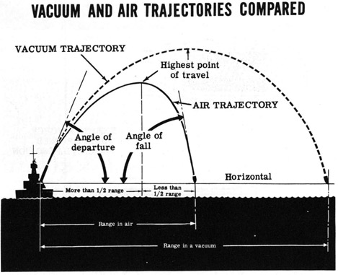
Projectiles and air resistance

Slide 168
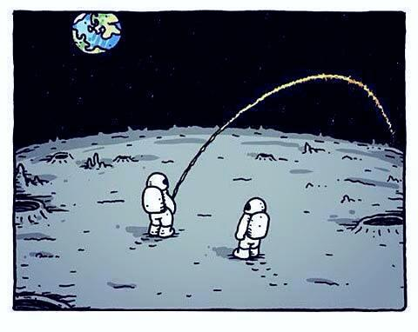
2.1 Projectile motion investigation

Slide 169
Assessment criteria?
Personal engagement - 2 marks (8%)
Exploration – 6 marks (25%)
Analysis – 6 marks (25%)
Evaluation – 6 marks (25%)
Communication – 4 marks (17%)
“Best fit approach”

Slide 170
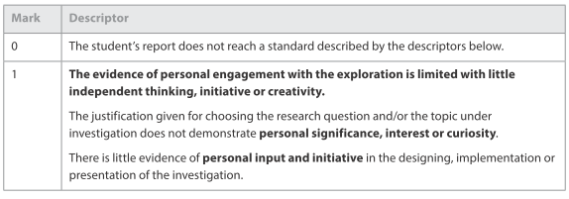
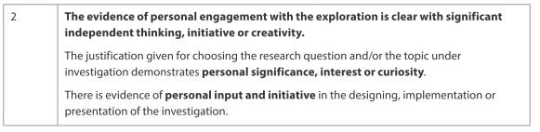
Personal engagement - 2

Slide 171
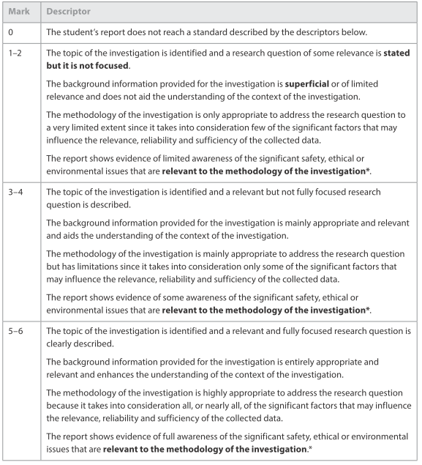
Exploration - 6

Slide 172
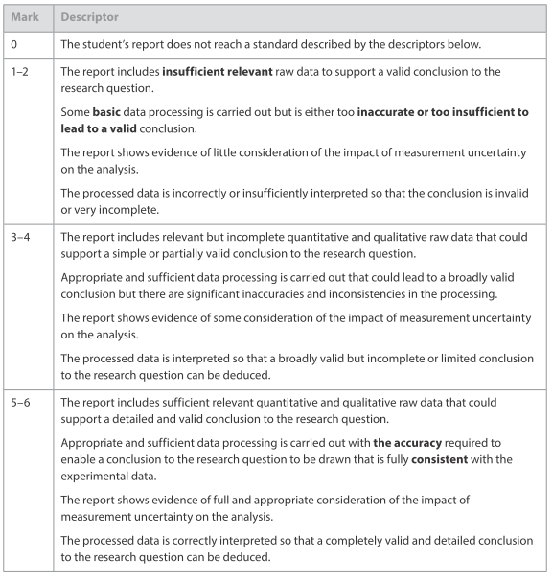
Analysis - 6

Slide 173
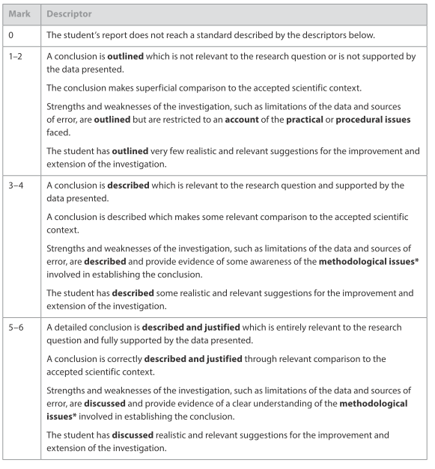
Evaluation - 6

Slide 174
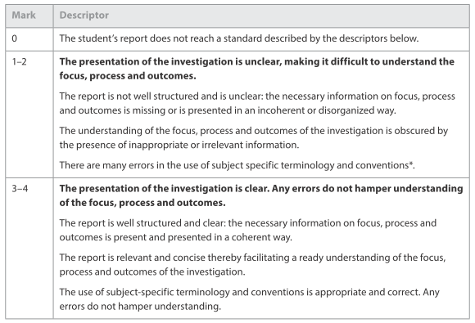
Communication - 4

